Slide 1

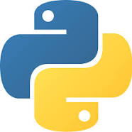
PYTHON PROGRAMMING
Debabrata Doloi

Slide 2
History of Pythons
Created in 1990 by Guido van Rossum
Named after Monty Python
First public release in 1991
comp.lang.python founded in 1994
Open source from the start

Slide 3
Python overview
Scripting Language
Object-Oriented
Portable
Powerful
Easy to learn and use
Mixes good features from Java, Perl and Scheme

Slide 4
Use of Python
System Utilities
GUIs (Tkinter, gtk, Qt, Windows)
Database Programming
Artificial Intelligence
Machine Learning
Deep Learning
Image Processing
……… etc .

Slide 5
Language Features
Object-Oriented
Dynamic
Interpreted
Functional
Interactive
Highly readable

Slide 6
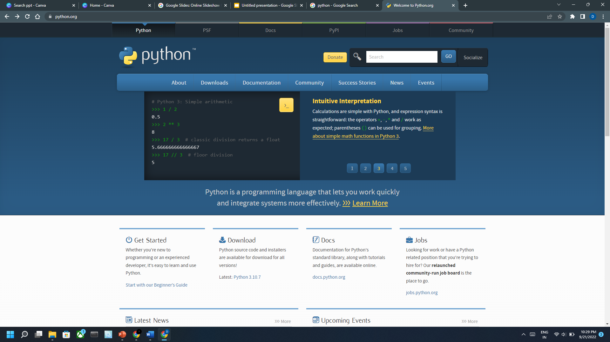
Installing Python
Windows :
Download Python from http://www.python.org
Install Python.
Run Idle from the Start Menu.

Slide 7
Installing Python
Linux :
•Chances are you already have Python installed. To check, run python from the terminal.
•If not, install from your distribution's package system.
MacOS :
•Python is already installed.
•Open a terminal and run python or run Idle from Finder.

Slide 8
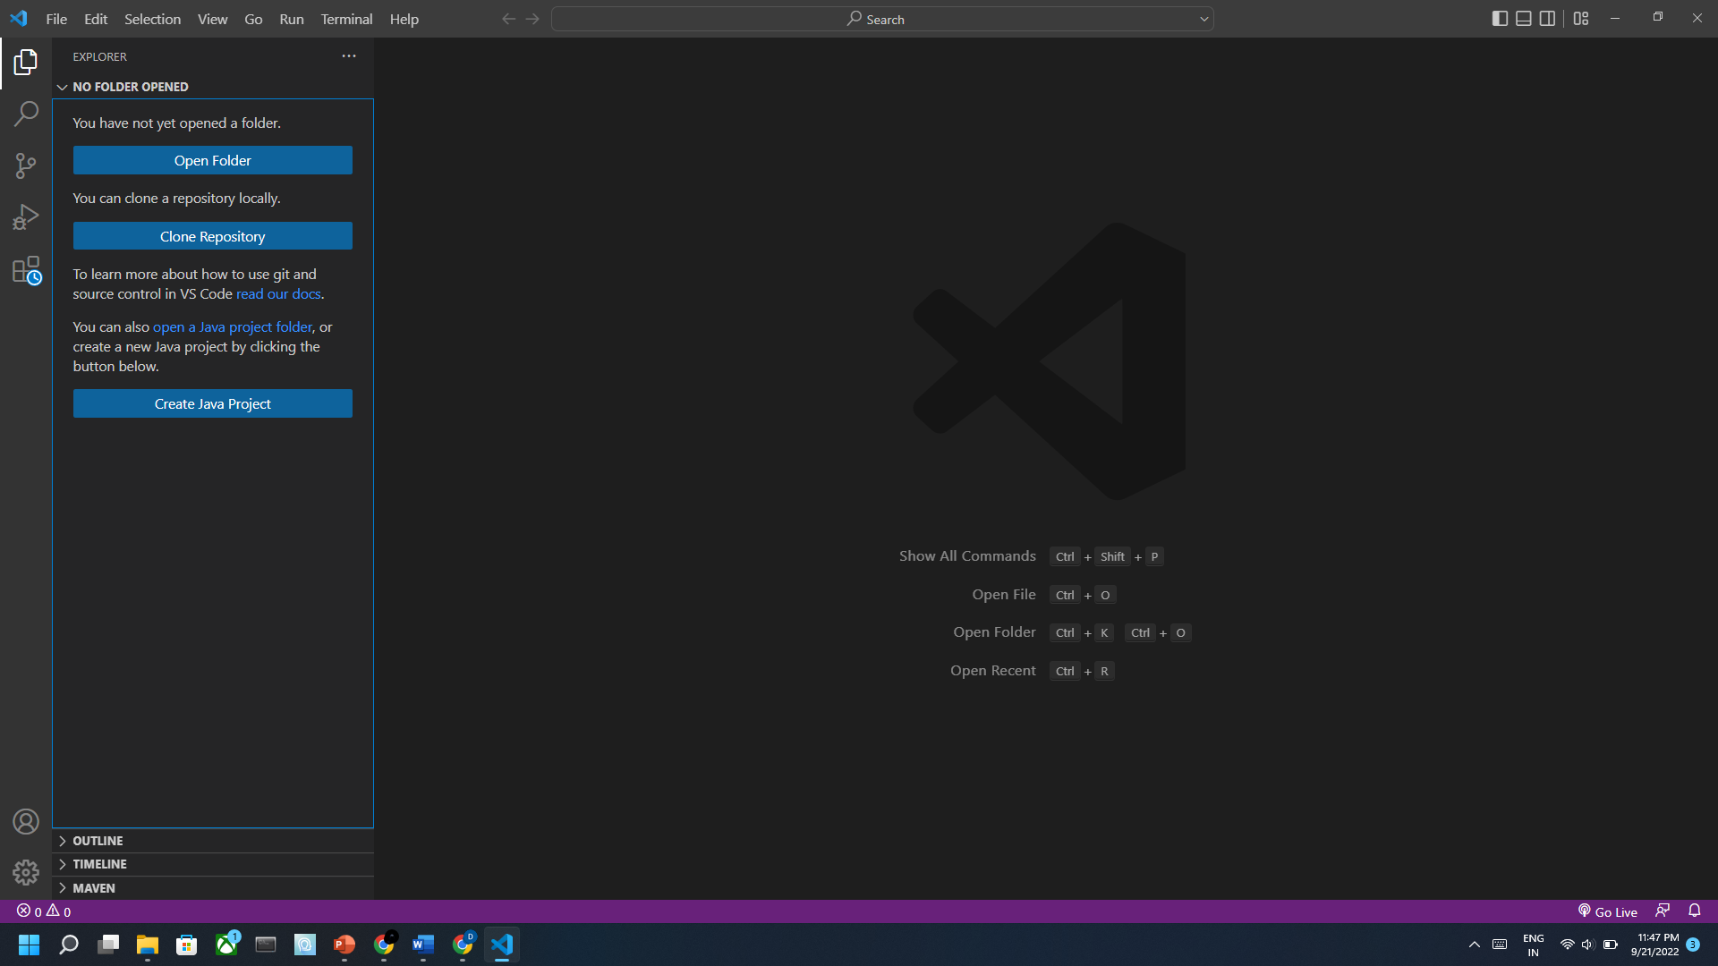
Installing Visual Studio Code
Download VsCode from https://code.visualstudio.com/download
Install Visual Studio Code .

Slide 9

Python Syntax

Slide 10
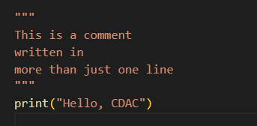

Python Comments
Single line comment
Multiline comment

Slide 11
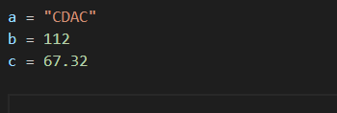
Python Variables
A variable is created the moment first assign a value to it.
Variables do not need to be declared with any particular type, and can even change type after they have been set.
Here a , b , c are the variable

Slide 12
Python Data Types
Variables can store data of different types, and different types can do different things.
Python has the following data types built-in by default, in these categories:
Text Type: str
Numeric Types: int, float, complex
Sequence Types: list, tuple, range
Mapping Type: dict
Set Types: set, frozenset
Boolean Type: bool
Binary Types: bytes, bytearray, memoryview
None Type: NoneType

Slide 13
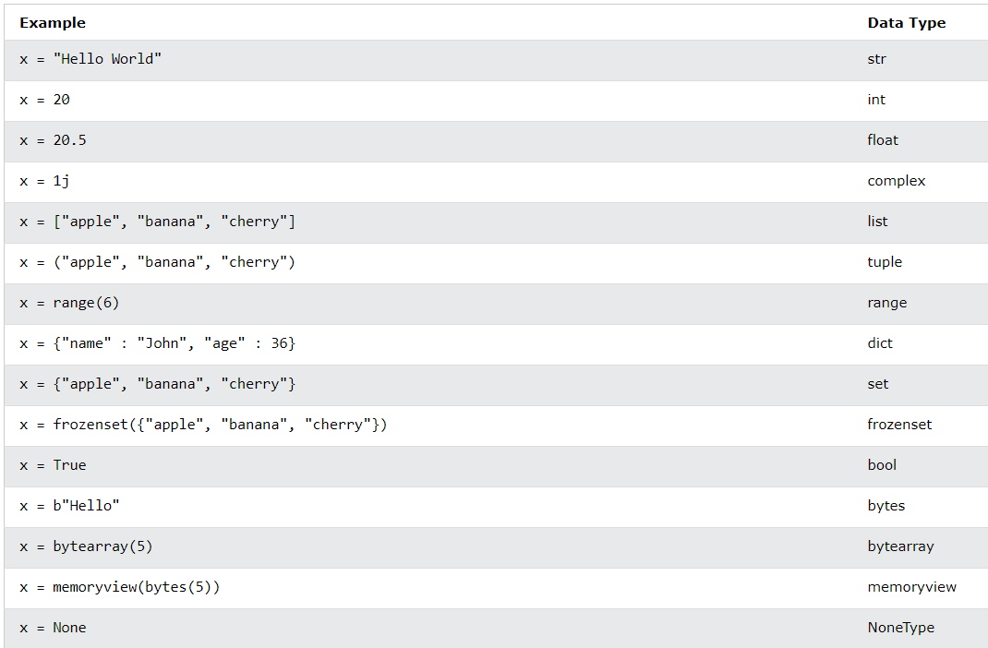
Data Types Example

Slide 14
Python Numbers
There are three numeric types in Python:
int ( Example : 23, 45, 56789…..)
float ( Example : 4.78 , 67.932…..)
complex ( Example : 3 + 4j , 5 - 7i…..)

Slide 15
Python Reserved Keyword
Python has a set of keywords that are reserved words that cannot be used as variable names, function names, or any other identifiers.
Keyword | Description
and | A logical operator
as | To create an alias
assert | For debugging
break | To break out a loop
class | To define a class
continue | To continue to the next iteration of a loop
def | To define a function
del | To delete an object
elif | Used in conditional statements, same as else if

Slide 16
Python Reserved Keyword
Keyword | Description
else | Used a conditional statement
except | Used with exceptions, what to do when an exception occurs
FALSE | Boolean value, result of comparison operations
finally | Used with exceptions, a block of code that will be executed no matter if there is an exception or not
for | To create a for loop
from | To import specific parts of a module
global | To declare a global variable
if | To make a conditional statement
import | To import a module
in | To check if a value is present in a list, tuple, etc.

Slide 17
Python Reserved Keyword
Keyword | Description
lambda | To create an anonymous function
None | Represents a null value
nonlocal | To declare a non-local variable
not | A logical operator
or | A logical operator
pass | A null statement, a statement that will do nothing
raise | To raise an exception
return | To exit a function and return a value
TRUE | Boolean value, result of comparison operations
try | To make a try...except statement

Slide 18
Python Reserved Keyword
Keyword | Description
while | To create a while loop
with | Used to simplify exception handling
yield | To end a function, returns a generator

Slide 19
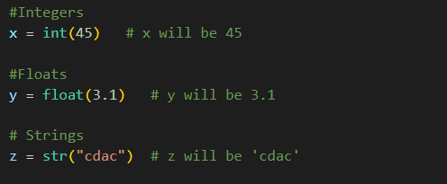
Type Casting
Specify a type on to a variable .

Slide 20
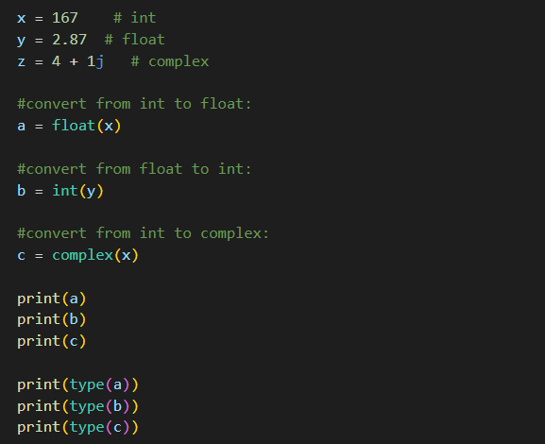
Type Conversion
Convert from one type to another .

Slide 21
Python Operators
Operators are used to perform operations on variables and values.
Python divides the operators in the following groups:
Arithmetic operators
Assignment operators
Comparison operators
Logical operators
Identity operators
Membership operators
Bitwise operators

Slide 22
Arithmetic Operators
Arithmetic operators are used with numeric values to perform common mathematical operations:
Operator | Name | Example
+ | Addition | X + Y
- | Subtraction | X - Y
* | Multiplication | X * Y
/ | Division | X / Y
% | Modulus | X % Y
** | Exponentiation | X ** Y
// | Floor Division | X // Y

Slide 23
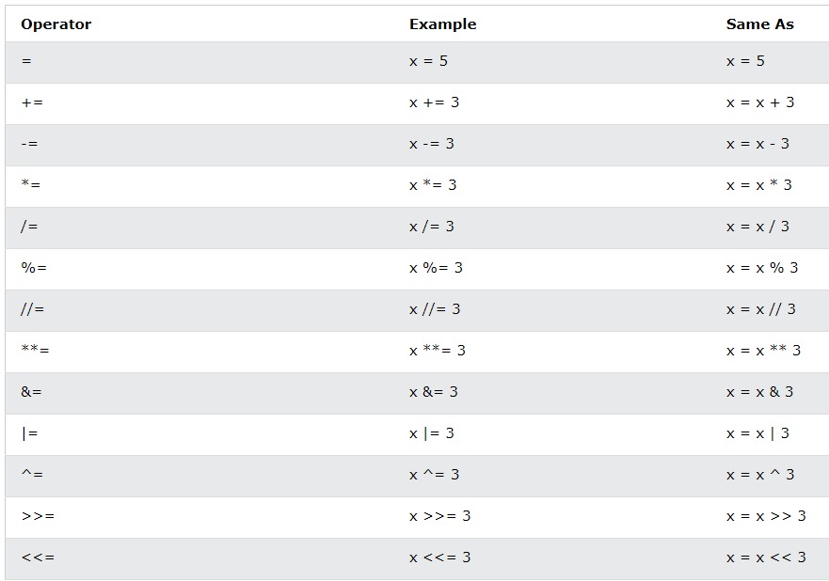
Assignment Operators

Slide 24
Comparison Operators
Comparison operators are used to compare two values:
Operator | Name | Example
== | Equal | X == Y
!= | Not Equal | X!= Y
> | Greater than | X > Y
< | Less than | X< Y
>= | Greater than equal | X >= Y
<= | Less than equal | X<= Y

Slide 25
Logical Operators
Logical operators are used to combine conditional statements:
Operator | Description | Example
and | Returns True if both statements are true | X>4 and X>8
or | Returns True if one of the statement is true | X>4 or X>8
not | Reverse the result , return true if the result is false | not( X>4 or X>8 )

Slide 26
Bitwise Operators
Bitwise operators are used to compare (binary) numbers:
Operator | Name | Description
& | AND | Sets each bit to 1 if both bits are 1
| | OR | Sets each bit to 1 if one of two bits is 1
^ | XOR | Sets each bit to 1 if only one of two bits is 1
~ | NOT | Inverts all the bits
>> | Sign right shift | Signed right shift Shift right by pushing copies of the leftmost bit in from the left, and let the rightmost bits fall off
<< | Zero fill left shift | Zero fill left shift Shift left by pushing zeros in from the right and let the leftmost bits fall off

Slide 27
Identity Operators
Identity operators are used to compare the objects, not if they are equal, but if they are actually the same object, with the same memory location:
Operator | Description | Example
is | Returns True if both variables are the same object | X is Y
Is not | Returns True if both variables are not the same object | X is not Y

Slide 28
Membership Operators
Membership operators are used to test if a sequence is presented in an object:
Operator | Description | Example
in | Returns True if a sequence with the specified value is present in the object | X in Y
not in | Returns True if a sequence with the specified value is not present in the object | X not in Y

Slide 29
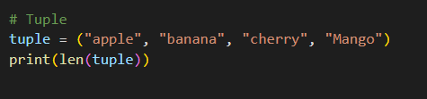
Tuple
Tuples are used to store multiple items in a single variable.
A tuple is a collection which is ordered and unchangeable.
Tuples are written with round brackets.
Tuple items are ordered, unchangeable, and allow duplicate values.
To determine how many items a tuple has, use the len() function .
Example :

Slide 30
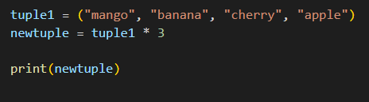
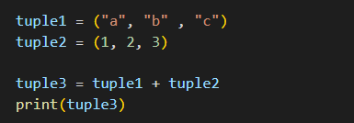
Tuple Join and Method
To join two or more tuples can use the + operator .
If want to multiply the content of a tuple a given number of times, can use the * operator .
Method | Description
count() | Returns the number of times a specified value occurs in a tuple
index() | Searches the tuple for a specified value and return the position where it was found

Slide 31
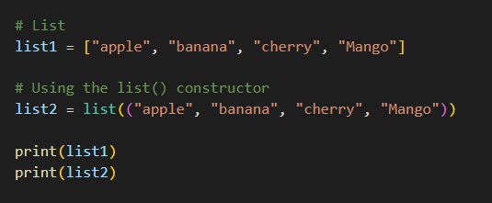
List
Lists are used to store multiple items in a single variable.
Lists are created using square brackets.
List items are ordered, changeable, and allow duplicate values.
List items are indexed, the first item has index [0], the second item has index [1] etc.
It is also possible to use the list() constructor when creating a new list.

Slide 32
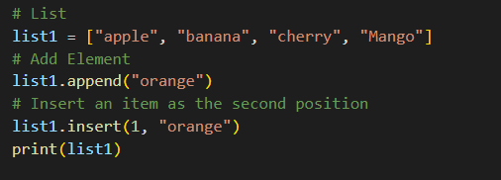
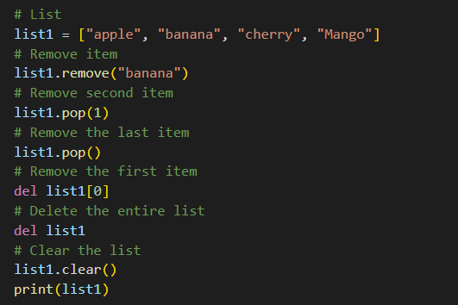
List
Using the append() method to append an item.
To insert a list item at a specified index, use the insert() method.
The remove() method removes the specified item.
The pop() method removes the specified index. If do not specify the index, the pop() method removes the last item.
The del keyword also removes the specified index and del keyword can also delete the list completely.
The clear() method empties the list, the list still remains but it has no content.

Slide 33
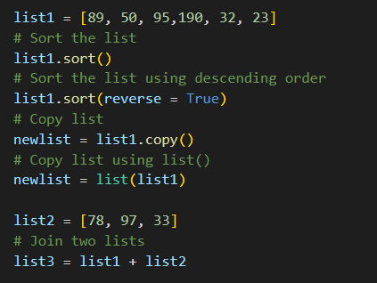
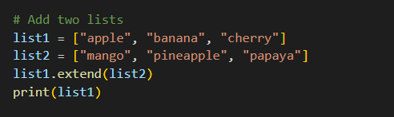
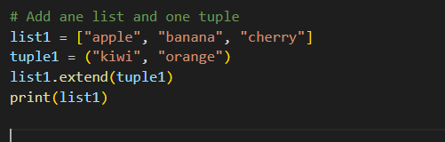
Special Cases of List
To append elements from another list to the current list, use the extend() method.
The extend() method does not have to append lists, you can add any iterable object (tuples, sets, dictionaries etc.).
List print using loop.
List Comprehension .
Sort , Copy and Join the lists .

Slide 34
List Methods
Method | Description
append() | Adds an element at the end of the list
clear() | Removes all the elements from the list
copy() | Returns a copy of the list
count() | Returns the number of elements with the specified value
extend() | Add the elements of a list ( or any iterable), to the end of the current list
index() | Returns the index of the first element with the specified value
insert() | Adds an element at the specified position
pop() | Removes the element at the specified position
remove() | Removes the item with the specified value
reverse() | Reverses the order of the list
sort() | Sorts the list

Slide 35


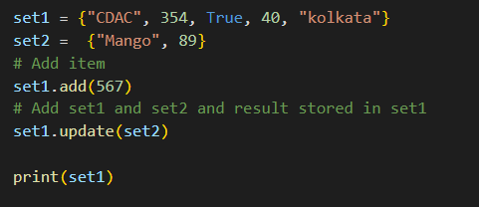
Set
Sets are used to store multiple items in a single variable.
A set is a collection which is unordered, unchangeable, and unindexed. But we can add items and remove items . And do not allow duplicate values.
Sets are written with curly brackets.
To determine how many items a set has, use the len() function.
It is also possible to use the set() constructor to make a set.
Add an item to a set, using the add() method.
To add items from another set into the current set, use the update() method.

Slide 36
Set
To remove an item in a set, use the remove(), or the discard() method.
Also use the pop() method to remove an item, but this method will remove the last item.
The clear() method empties the set.
The del keyword will delete the set completely.
use the union() method that returns a new set containing all items from both sets, or the update() method that inserts all the items from one set into another.
The intersection_update() method will keep only the items that are present in both sets.
The intersection() method will return a new set, that only contains the items that are present in both sets.
The symmetric_difference_update() method will keep only the elements that are NOT present in both sets.
The symmetric_difference() method will return a new set, that contains only the elements that are NOT present in both sets.

Slide 37
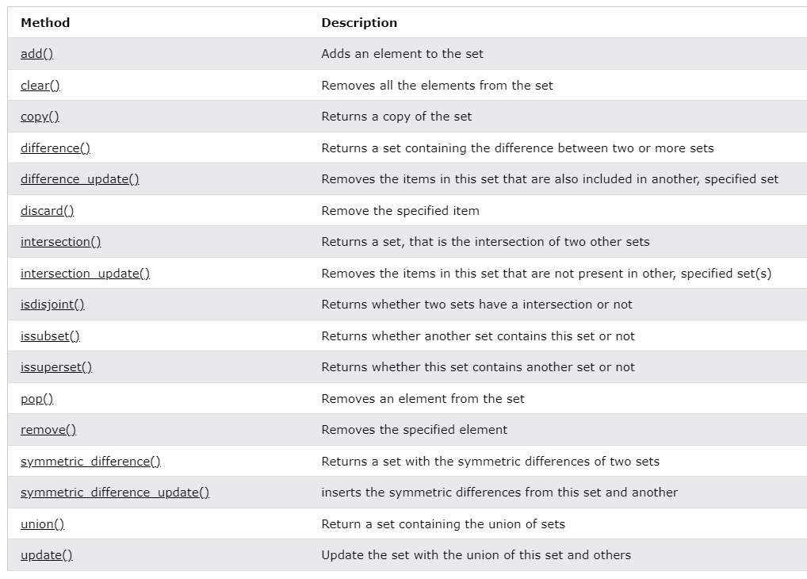
Set Methods

Slide 38
Dictionary
Dictionaries are used to store data values in key:value pairs.
A dictionary is a collection which is ordered , changeable and do not allow duplicates.
Access the items of a dictionary by referring to its key name, inside square brackets. And also a method called get() that will give the same result .
The keys() method will return a list of all the keys in the dictionary.
The values() method will return a list of all the values in the dictionary.
The items() method will return each item in a dictionary, as tuples in a list.
The update() method will update the dictionary with the items from the given argument.
The update() method will update the dictionary with the items from a given argument. If the item does not exist, the item will be added.
The pop() method removes the item with the specified key name.
The popitem() method removes the last inserted item .
The del keyword removes the item with the specified key name , it can also delete the dictionary completely.
The clear() method empties the dictionary.

Slide 39
Dictionary
There are ways to make a copy, one way is to use the built-in Dictionary method copy().
Another way to make a copy is to use the built-in function dict().
A dictionary can contain dictionaries, this is called nested dictionaries.

Slide 40
Dictionary Method
Method | Description
clear() | Removes all the elements from the dictionary
copy() | Returns a copy of the dictionary
fromkeys() | Returns a dictionary with the specified keys and value
get() | Returns the value of the specified key
items() | Returns a list containing a tuple for each key value pair
keys() | Returns a list containing the dictionary's keys
pop() | Removes the element with the specified key
popitem() | Removes the last inserted key-value pair
setdefault() | Returns the value of the specified key. If the key does not exist: insert the key, with the specified value
update() | Updates the dictionary with the specified key-value pairs
values() | Returns a list of all the values in the dictionary

Slide 41
Array
An array is a collection of items stored at contiguous memory locations. The idea is to store multiple items of the same type together. This makes it easier to calculate the position of each element by simply adding an offset to a base value, i.e., the memory location of the first element of the array (generally denoted by the name of the array).
Array in Python can be created by importing array module. array(data_type, value_list) is used to create an array with data type and value list specified in its arguments.
Array operations :
Traverse - It prints all the elements one by one.
Insertion - It adds an element at the given index.
Deletion - It deletes an element at the given index.
Search - It searches an element using the given index or by the value.
Update - It updates an element at the given index.

Slide 42
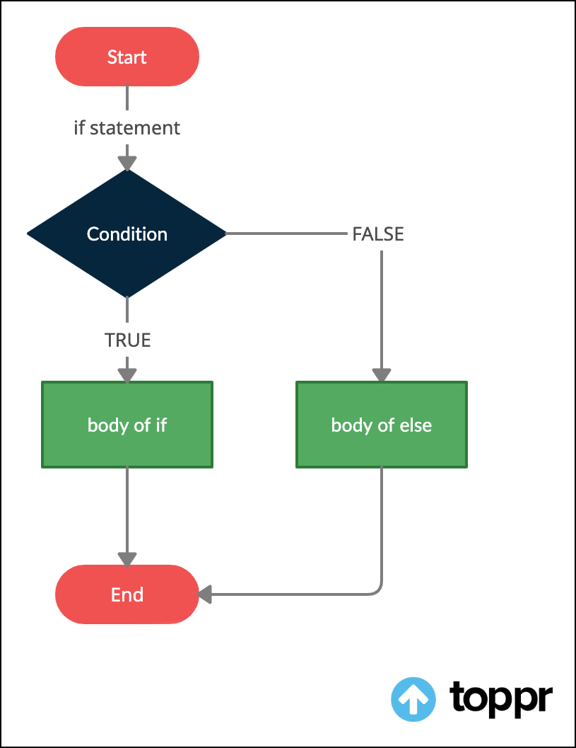


Python If Else Statement
If Statement :- The if statement is used to test a specific condition. If the condition is true, a block of code (if-block) will be executed.
If-Else Statement :- The if-else statement is similar to if statement except the fact that, it also provides the block of the code for the false case of the condition to be checked. If the condition provided in the if statement is false, then the else statement will be executed.
Nested if statement , Nested if-else statement.
The elif keyword is pythons way of saying "if the previous conditions were not true, then try this condition".

Slide 43
If Else Statement Condition
Equals: a == b
Not Equals: a != b
Less than: a < b
Greater than: a > b
Less than or equal to: a <= b
Greater than or equal to: a >= b

Slide 44
Python Loops
For loop :- This type of loop executes a code block multiple times and abbreviates the code that manages the loop variable.
While loop :- This type of loop executes a code block multiple times and abbreviates the code that manages the loop variable.
Nested loops :- We can iterate a loop inside another loop.

Slide 45

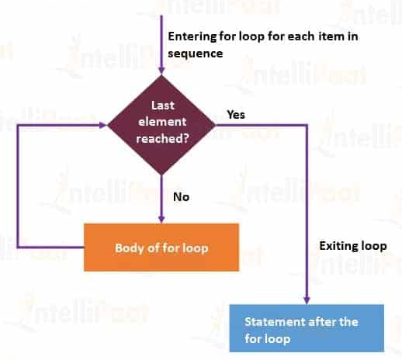
For Loop
Python For loop is used for sequential traversal i.e.it is used for iterating over an iterable like String, Tuple, List, Set or Dictionary.
In Python, there is no C style for loop, i.e., for (i=0; i<n; i++). There is “for” loop which is similar to each loop in other languages.
Python For Loop Syntax :
Flow Chart

Slide 46



For Loop
With the break statement we can stop the loop before it has looped through all the items.
With the continue statement we can stop the current iteration of the loop,and continue with the next.
The range() function returns a sequence of numbers, starting from 0 by default, and increments by 1 (by default), and ends at a specified number.
The else keyword in a for loop specifies a block of code to be executed when the loop is finished.
For loops cannot be empty, but for some reason have a for loop with no content, put in the pass statement to avoid getting an error.

Slide 47
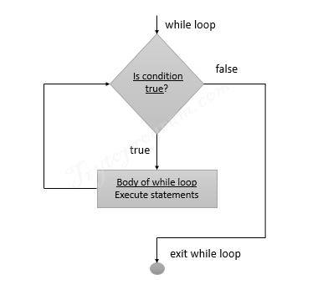

While Loop
Python While Loop is used to execute a block of statements repeatedly until a given condition is satisfied. And when the condition becomes false, the line immediately after the loop in the program is executed.
While loop falls under the category of indefinite iteration. Indefinite iteration means that the number of times the loop is executed isn’t specified explicitly in advance.
Python While Loop Syntax :
Flow Chart

Slide 48
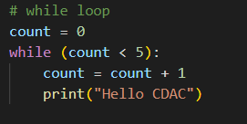
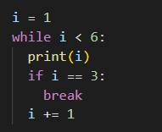
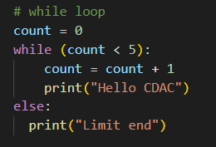
While Loop
With the break statement we can stop the loop even if the while condition is true.
With the continue statement we can stop the current iteration, and continue with the next.
With the else statement we can run a block of code once when the condition no longer is true.

Slide 49
Python Break and Continue Statement
The break is a keyword in python which is used to bring the program control out of the loop.

Slide 50
Functions
A function is a block of code that only runs when it is called.
Pass data, known as parameters, into a function.
A function can return data as a result.
In Python a function is defined using the def keyword.
Information can be passed into functions as arguments. Arguments are specified after the function name, inside the parentheses.

Slide 51
Python Lambda
A lambda function is a small anonymous function.
A lambda function can take any number of arguments, but can only have one expression.
Syntax : lambda arguments : expression .

Slide 52
File Handling
File handling is an important part of any web application.
Python has several functions for creating, reading, updating, and deleting files.
The key function for working with files in Python is the open() function.
The open() function takes two parameters; filename, and mode.
There are four different methods (modes) for opening a file:
"r" - Read - Default value. Opens a file for reading, error if the file does not exist.
"a" - Append - Opens a file for appending, and creates the file if it does not exist.
"w" - Write - Opens a file for writing, and creates the file if it does not exist.
"x" - Create - Creates the specified file, and returns an error if the file exist.

Slide 53
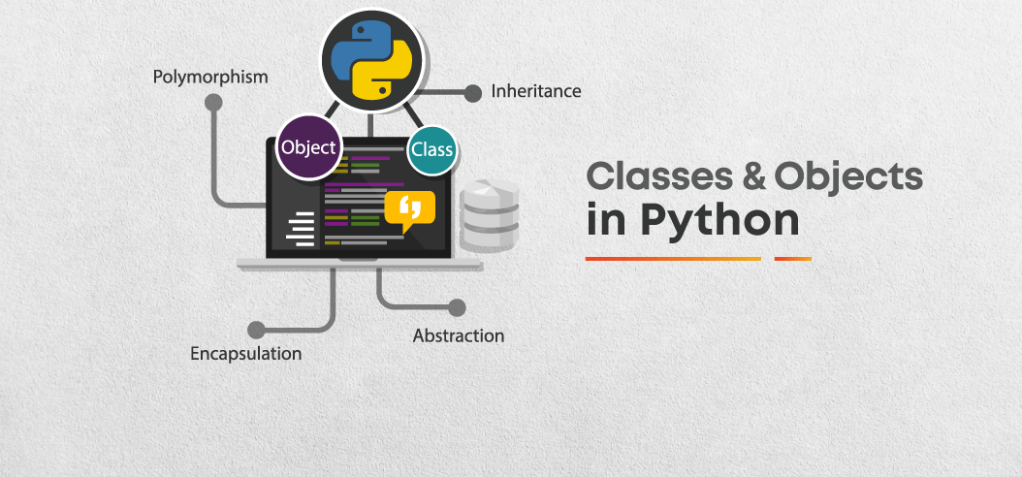
Python Class/Objects
Python is an object-oriented programming language.
Almost everything in Python is an object, with its properties and methods.
A Class is like an object constructor or a "blueprint" for creating objects.
To create a class, use the keyword class.

Slide 54
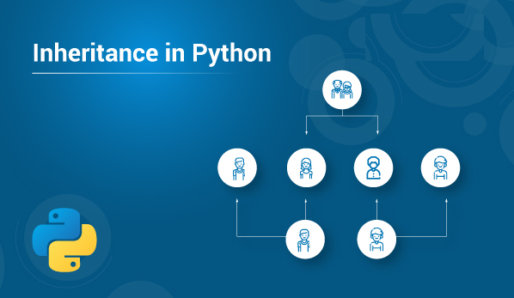
Python Inheritance
Inheritance allows us to define a class that inherits all the methods and properties from another class.
Parent class is the class being inherited from, also called base class.
Child class is the class that inherits from another class, also called derived class.

Slide 55
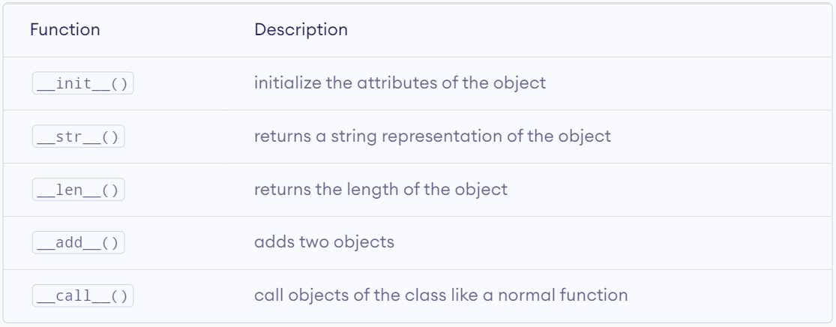
Operator Overloading
Class functions that begin with double underscore __ are called special functions in Python.
The special functions are defined by the Python interpreter and used to implement certain features or behaviors.
They are called "double underscore" functions because they have a double underscore prefix and suffix, such as __init__() or __add__().

Slide 56
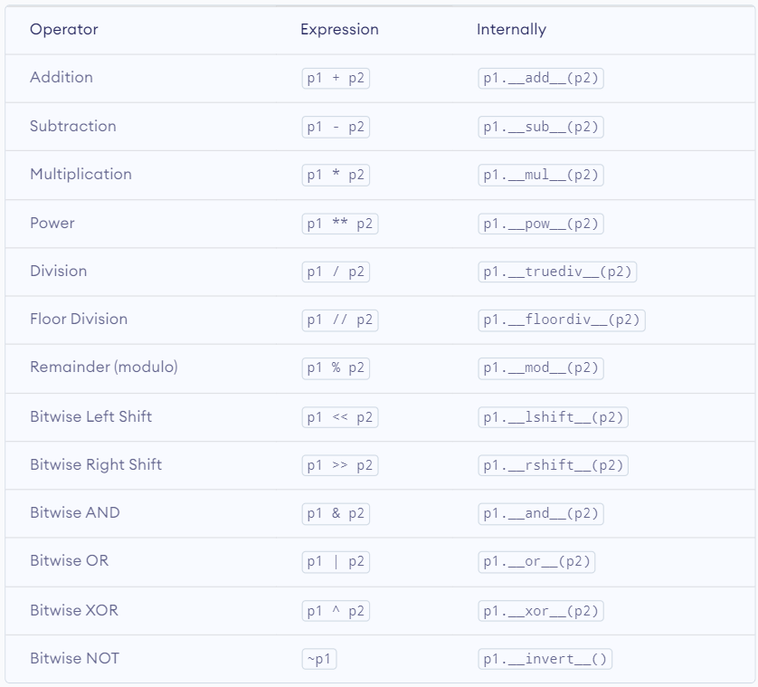
Operator Overloading

Slide 57
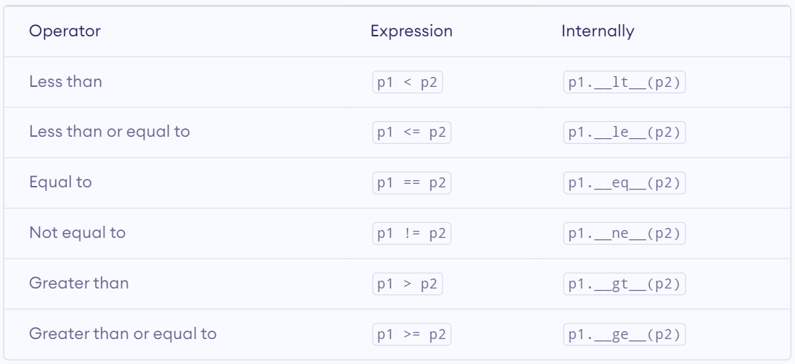
Operator Overloading

Slide 58
Operator Overloading
Advantage of Operator Overloading-
Improves code readability by allowing the use of familiar operators.
Ensures that objects of a class behave consistently with built-in types and other user-defined types.
Makes it simpler to write code, especially for complex data types.
Allows for code reuse by implementing one operator method and using it for other operators.

Slide 59
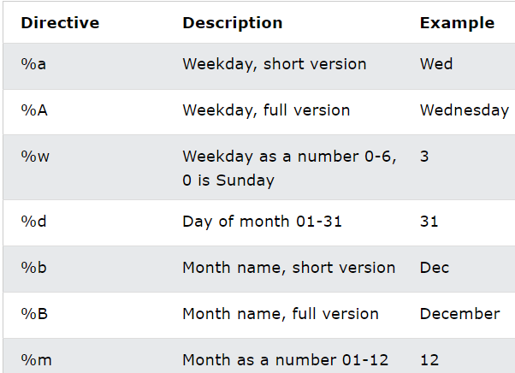
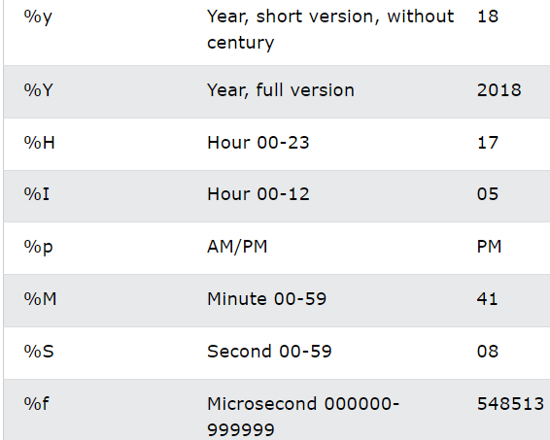
Python Dates
A date in Python is not a data type of its own, but we can import a module named datetime to work with dates as date objects.

Slide 60
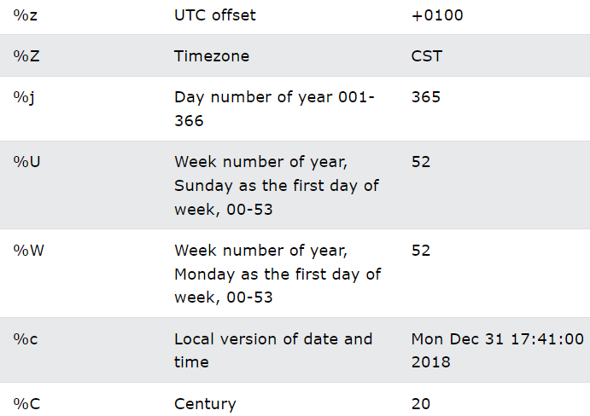
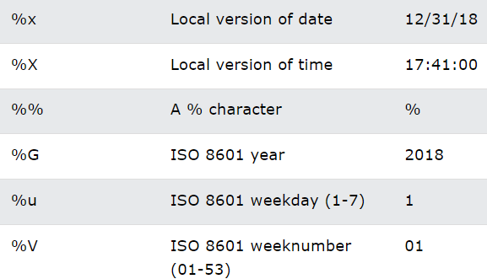
Python Dates

Slide 61
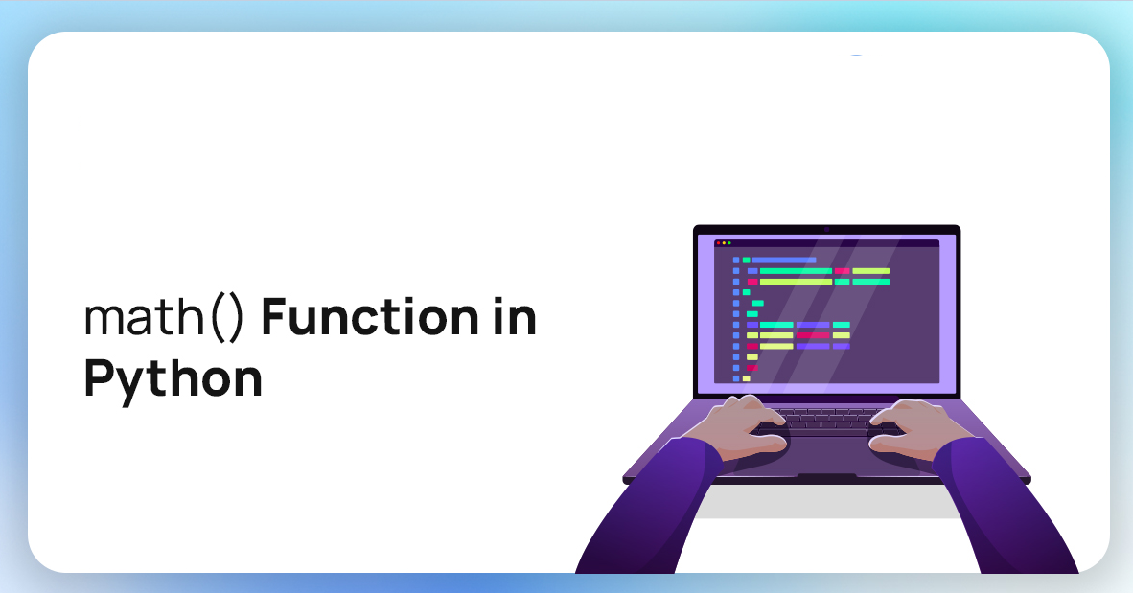
Python Math
Python has a set of built-in math functions, including an extensive math module, that allows to perform mathematical tasks on numbers.
The min() and max() functions can be used to find the lowest or highest value in an iterable.
The abs() function returns the absolute (positive) value of the specified number.
The pow(x, y) function returns the value of x to the power of y (xy).

Slide 62
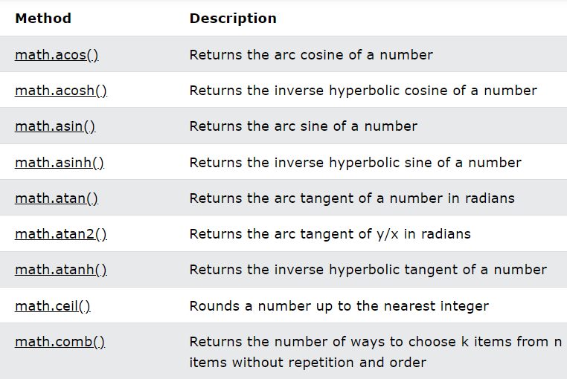
Python Math Module
Python has also a built-in module called math, which extends the list of mathematical functions.

Slide 63
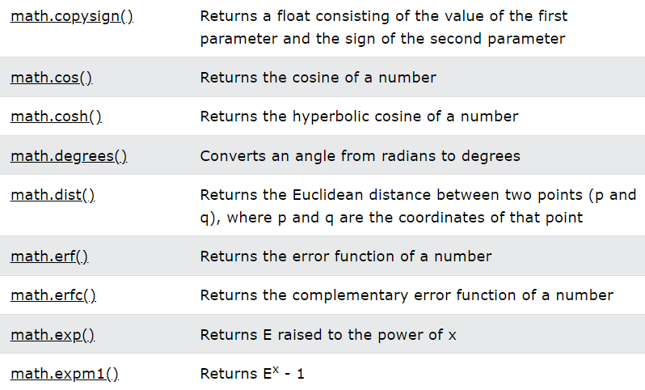
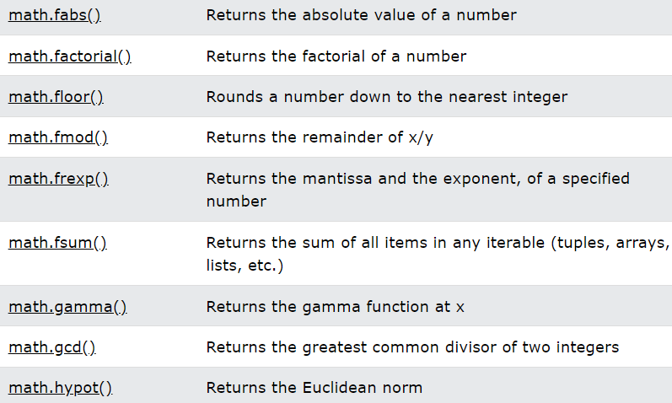
Python Math Module

Slide 64
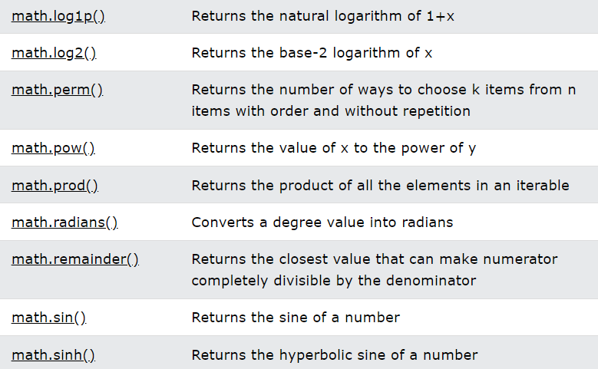
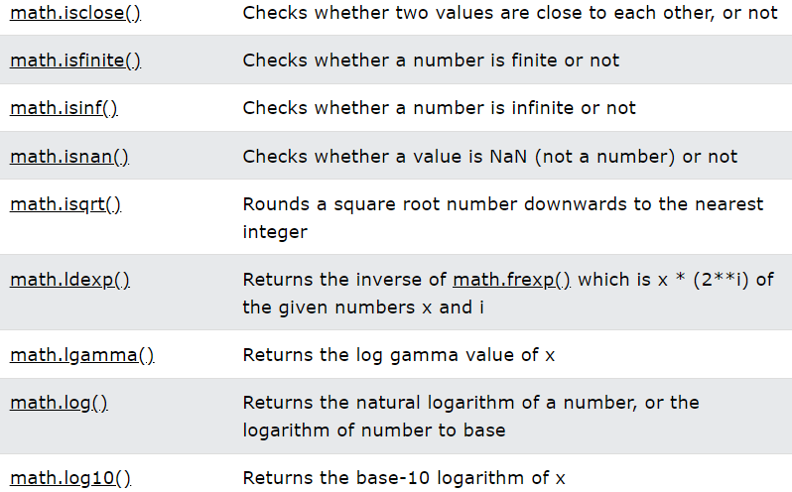
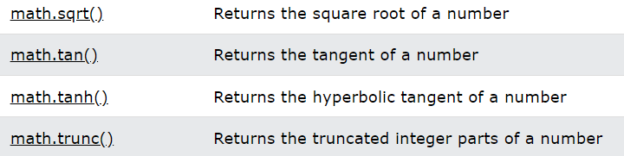
Python Math Module

Slide 65
Python Exception Handling
Error in Python can be of two types i.e. Syntax errors and Exceptions. Errors are the problems in a program due to which the program will stop the execution. On the other hand, exceptions are raised when some internal events occur which changes the normal flow of the program.
Some of the common Exception Errors are –
IOError: if the file can’t be opened
KeyboardInterrupt: when an unrequired key is pressed by the user
ValueError: when the built-in function receives a wrong argument
EOFError: if End-Of-File is hit without reading any data
ImportError: if it is unable to find the module
- Try and Except statement is used to handle these errors.

Slide 66
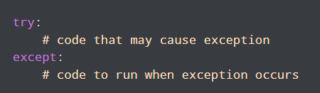
Python Exception Handling ( Try..Except Block)
The try block lets you test a block of code for errors.
The except block lets you handle the error.
The else block lets you execute code when there is no error.
The finally block lets you execute code, regardless of the result of the try- and except blocks.

Slide 67
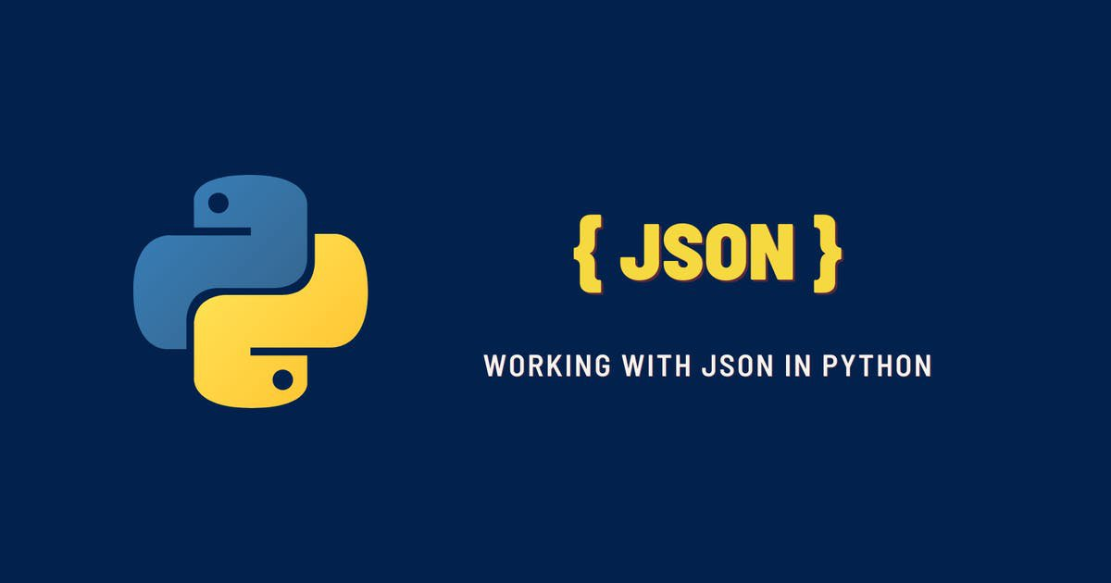
Python Json
JSON is a syntax for storing and exchanging data.
JSON is text, written with JavaScript object notation.

Slide 68


Numpy
NumPy is a Python library.
NumPy is used for working with arrays.
NumPy is short for "Numerical Python".
NumPy stands for numeric python which is a python package for the computation and processing of the multidimensional and single dimensional array elements.
It is an extension module of Python which is mostly written in C.
It provides various functions which are capable of performing the numeric computations with a high speed.
Installation of Numpy -

Slide 69
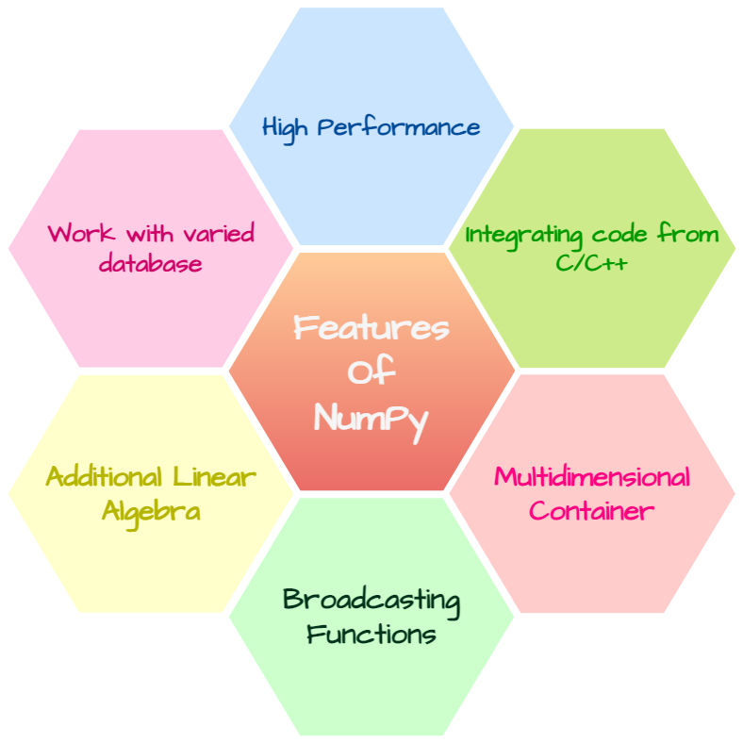
Numpy
NumPy provides a convenient and efficient way to handle the vast amount of data.
NumPy is also very convenient with Matrix multiplication and data reshaping.
NumPy is fast which makes it reasonable to work with a large set of data.
Slicing array -
We pass slice instead of index like this: [start:end].
We can also define the step, like this: [start:end:step].
If we don't pass start its considered 0
If we don't pass end its considered length of array in that dimension
If we don't pass step its considered 1 .

Slide 70
Numpy ( Random Number)
Random number does NOT mean a different number every time. Random means something that can not be predicted logically.
The random module's rand() method returns a random float between 0 and 1.
The randint() method takes a size parameter where you can specify the shape of an array.
The rand() method also allows you to specify the shape of the array.
The choice() method allows you to generate a random value based on an array of values.
The choice() method takes an array as a parameter and randomly returns one of the values.
LCM and GCD .
NumPy's unique() method to find unique elements from any array.
NumPy provides the ufuncs sin(), cos() and tan() that take values in radians and produce the corresponding sin, cos and tan values.

Slide 71
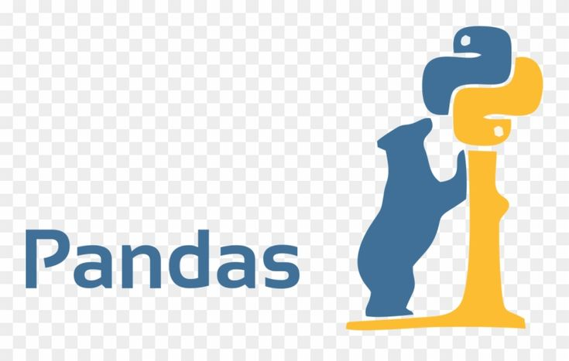
Pandas
Pandas is a Python library used for working with data sets.
It has functions for analyzing, cleaning, exploring, and manipulating data.
Pandas allows us to analyze big data and make conclusions based on statistical theories.
Pandas can clean messy data sets, and make them readable and relevant.
Relevant data is very important in data science.
A Pandas DataFrame is a 2-dimensional data structure, like a 2-dimensional array, or a table with rows and columns.

Slide 72
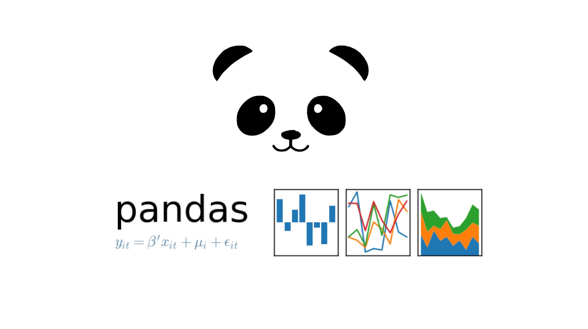
Key Features of Pandas
It has a fast and efficient DataFrame object with the default and customized indexing.
Used for reshaping and pivoting of the data sets.
Group by data for aggregations and transformations.
It is used for data alignment and integration of the missing data.
Provide the functionality of Time Series.
Process a variety of data sets in different formats like matrix data, tabular heterogeneous, time series.
Handle multiple operations of the data sets such as subsetting, slicing, filtering, groupBy, re-ordering, and re-shaping.
It integrates with the other libraries such as SciPy, and scikit-learn.
Provides fast performance, and If you want to speed it, even more, you can use the Cython.

Slide 73

Pandas Data Cleaning
Data cleaning means fixing bad data in your data set.
Empty cells
Data in wrong format
Wrong data
Duplicates
Empty cells can potentially give you a wrong result when you analyze data.

Slide 74
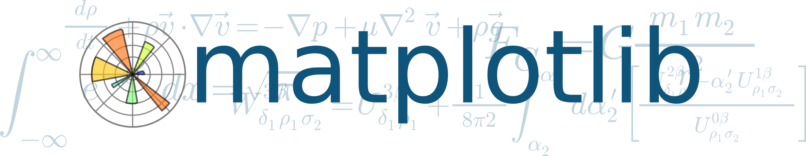
Matplotlib
Matplotlib is a low level graph plotting library in python that serves as a visualization utility.
Matplotlib was created by John D. Hunter.
Matplotlib is open source and we can use it freely.
The plot() function is used to draw points (markers) in a diagram.
The xlabel() and ylabel() functions to set a label for the x- and y-axis.
The scatter() function to draw a scatter plot.
The bar() function to draw bar graphs.
A histogram is a graph showing frequency distributions.
The hist() function will read the array and produce a histogram .
The pie() function to draw pie charts.

Slide 75
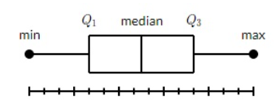
Matplotlib Box Plot
A box plot which is also known as a whisker plot displays a summary of a set of data containing the minimum, first quartile, median, third quartile, and maximum. In a box plot, we draw a box from the first quartile to the third quartile. A vertical line goes through the box at the median. The whiskers go from each quartile to the minimum or maximum.

Slide 76
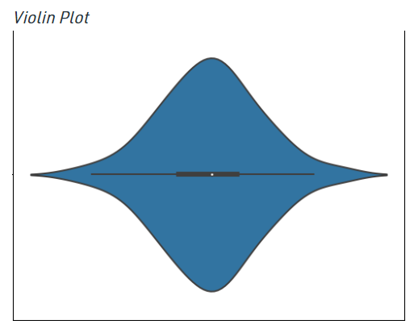
Matplotlib violin Plot
Violin plots are a combination of box plot and histograms. It portrays the distribution, median, interquartile range of data. So we see that iqr and median are the statistical information provided by box plot whereas distribution is being provided by the histogram.

Slide 77

Python Tkinter
Tkinter is the most commonly used library for developing GUI (Graphical User Interface) in Python. It is a standard Python interface to the Tk GUI toolkit shipped with Python. As Tk and Tkinter are available on most of the Unix platforms as well as on the Windows system, developing GUI applications with Tkinter becomes the fastest and easiest.
Developing desktop based applications with python Tkinter is not a complex task. An empty Tkinter top-level window can be created by using the following steps -
import the Tkinter module.
Create the main application window.
Add the widgets like labels, buttons, frames, etc. to the window.
Call the main event loop so that the actions can take place on the user's computer screen.

Slide 78

Python Tkinter Install

Slide 79

Python Tkinter Widgets

Slide 80

Python Tkinter Widgets

